Slide 1
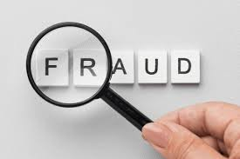
Frauds

Slide 2
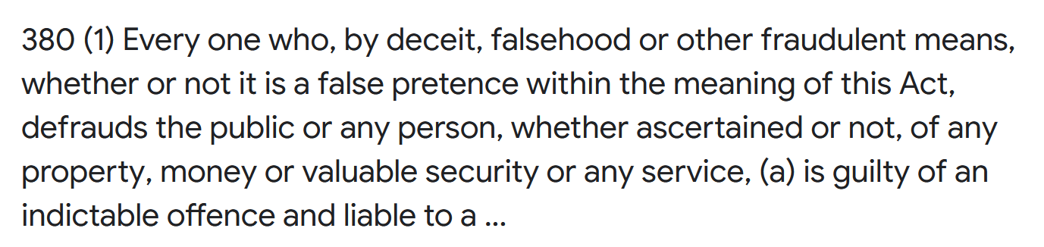
What is fraud?
Fraud is a form of theft that is achieved by deception (and not through force).

Slide 3
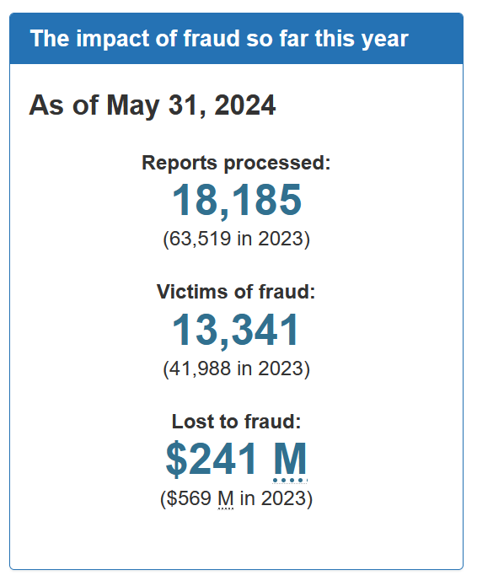
Canadian Fraud Centre (5 months of data)

Slide 4
Early thinking on fraud focused on white collar crime
Early work on fraud focused more on the crime and the perpetrator
One of the first major studies on fraud was Sutherland’s work on “white colour crime”
Donald R. Cressey developed Sutherland’s work, developing the “Fraud Triangle”, which focused on why people commit fraud.
opportunity, rationalization, and financial pressure.

Slide 5
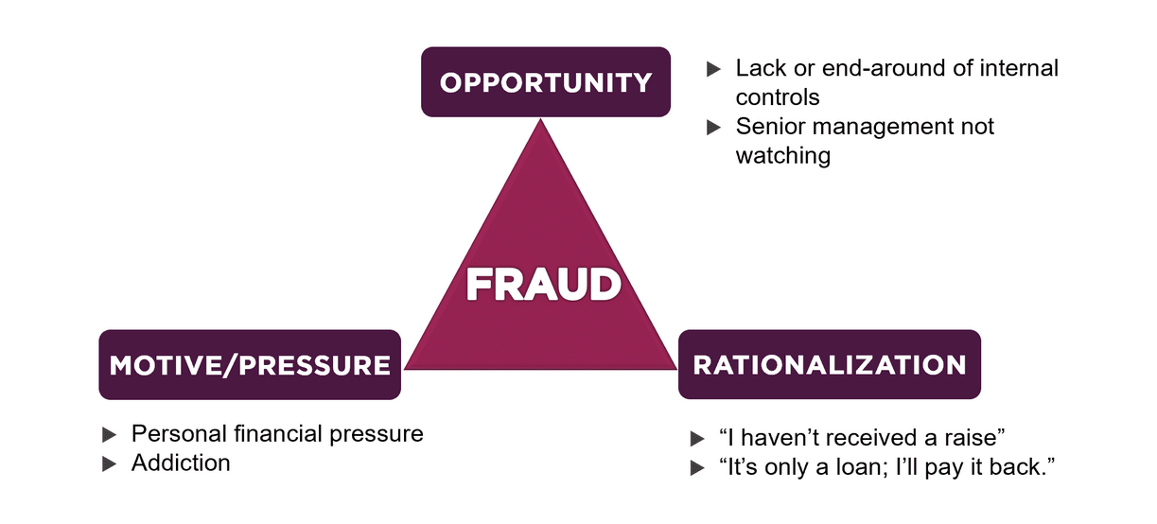
Of these, victimization is most clearly linked to “opportunity” (sound familiar?)
If we can focus on minimizing opportunities by working with potential victims (ie. businesses), we can reduce frauds.
Anders 2024

Slide 6
A-B-C model (Ramamoorti 2009)
A: A bad Apple is an individual who commits an individual fraud
B: A bad Bushel is a group of individuals who work together (in collusion) to commit fraud/s
C: A bad Crop is when an entire company, institution, industry and/or culture/sub-culture is toxic (e.g. the sub-prime mortgage scandal that caused a worldwide recession in 2007/8, which was caused by an unregulated market of predatory loans to largely low-income, low-information borrowers.

Slide 7
More recent academic theories of fraud victimization
Personality traits: Psychologists have tended to focus on personality-based theories, introversion/extraversion
According to a recent systematic review, there is no strong evidence that personality is tied to victimization (Norris, Brookes, Dowell 2019).
Extrovert:
Risk-taker
Introvert:
risk averse

Slide 8
How do people get deceived?
Some very common cognitive biases:
Priming bias: the tendency to be influenced by our first exposure to an individual/issue, etc.
Cognitive dissonance: when individuals encounter inconsistencies in relation to something in which they believe, they make search for information that reconfirms their views
Confirmation bias: tendency to interpret information in a way that confirms our existing opinions
Affinity bias: we tend to be biased by individuals who seem most like us
Status quo bias: preferring the status quo to a different choice that might lead to a loss.

Slide 9
How does ?
Some very common cognitive biases:
Priming bias: the tendency to be influenced by our first exposure to an individual/issue, etc.
Cognitive dissonance: when individuals encounter inconsistencies in relation to something in which they believe, they make search for information that reconfirms their views
Confirmation bias: tendency to interpret information in a way that confirms our existing opinions
Affinity bias: we tend to be biased by individuals who seem most like us
Status quo bias: preferring the status quo to a different choice that might lead to a loss.

Slide 10
Non-academic explanations
Gullible, Greedy and/or Stupid – this is a classic example of victim blaming. Victim blaming is a common response that says to the victim, “you deserved it.”
It’s a common response because it allows individuals to feel (falsely) psychologically secure, resting in the belief fraud victimization could never happen to them. (see Dunning-Kruger as one reason why this is highly likely to be incorrect).

Slide 11


What is Dunning-Kruger?
This is the term coined for a common cognitive bias where … an individual, who lacks any particular knowledge of, or skill in a subject, over-estimates/is over-confident in their knowledge, skills or abilities in that area.
MEET CHEWEY

Slide 12
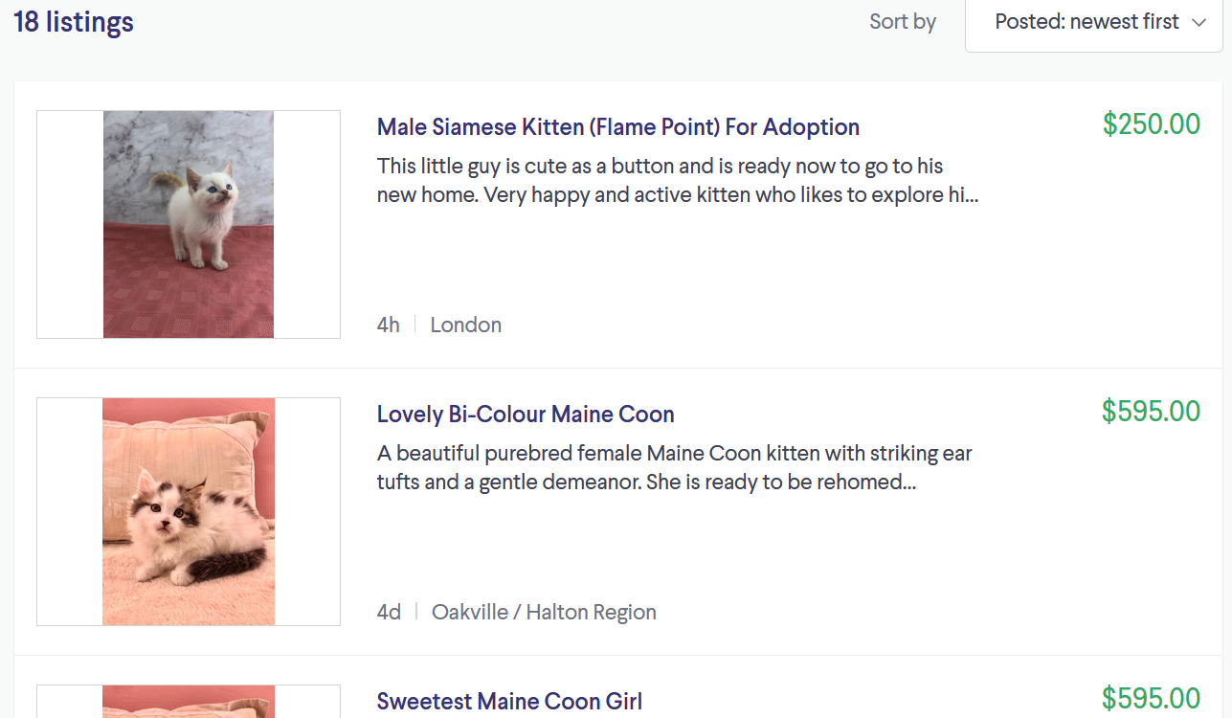
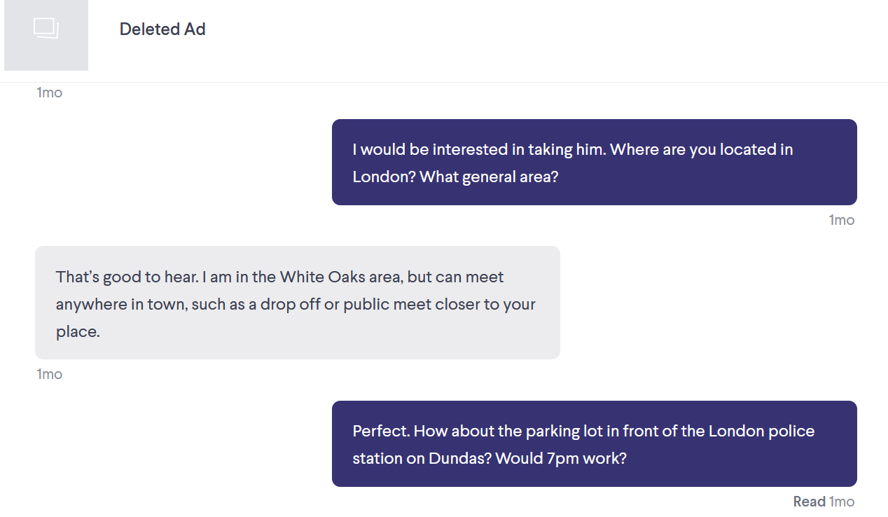
Online shopping fraud

Slide 13
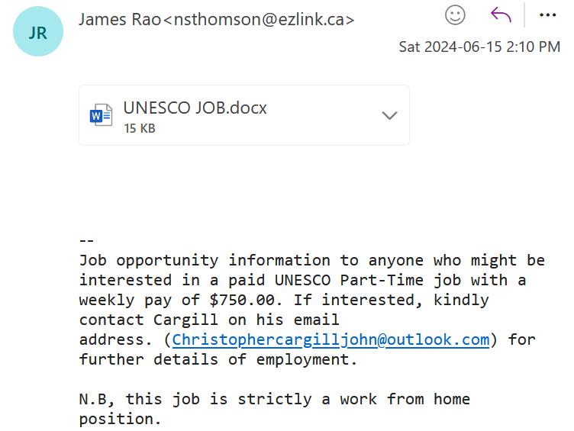
Email scams

Slide 14
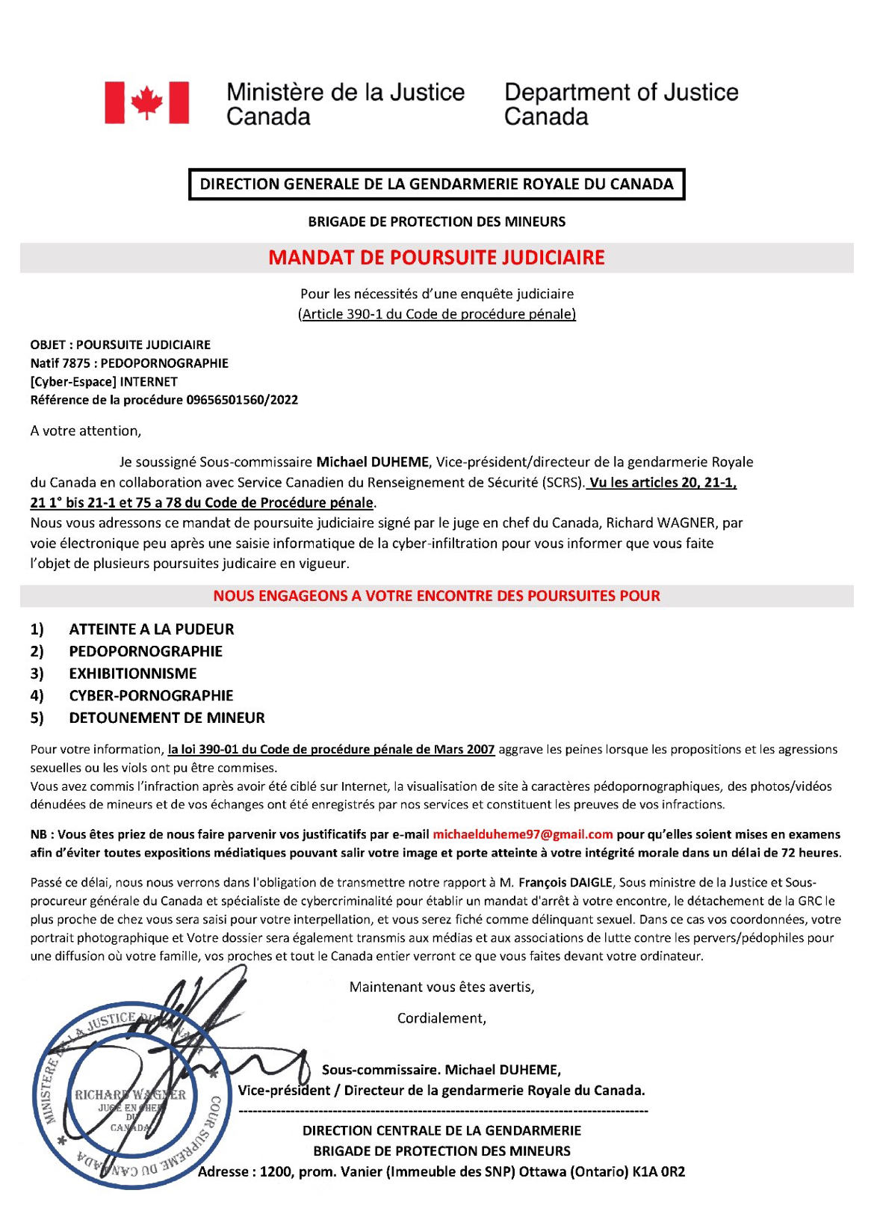
What will happen when fraudsters start really working with AI?

Slide 15
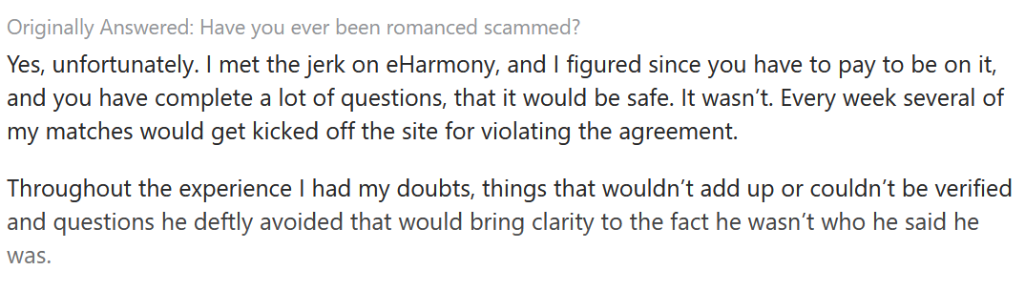
Online romance scams
This is from someone who is a psychologist. In other words, highly educated, rational person.

Slide 16
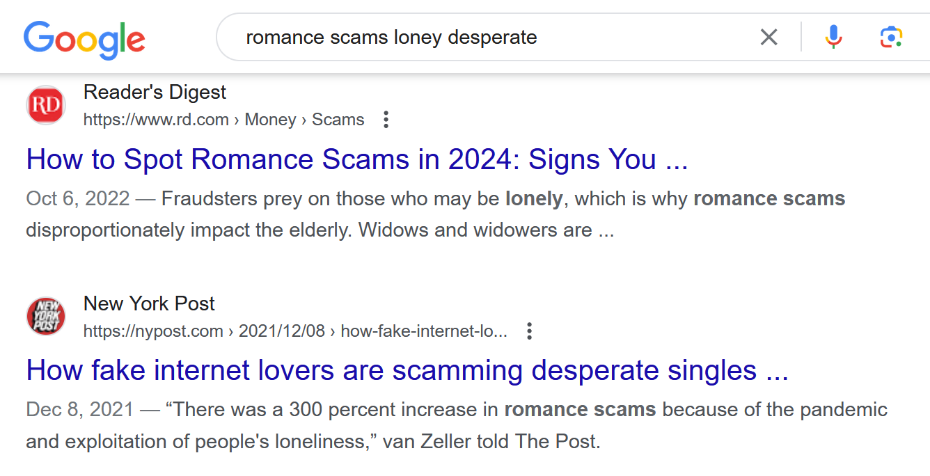
A common theory of romance scams:

Slide 17
How do people get sucked in?
Some very common cognitive biases:
Priming bias: the tendency to be influenced by our first exposure to an individual/issue, etc.
Cognitive dissonance: when individuals encounter inconsistencies in relation to something in which they believe, they make search for information that reconfirms their views
Confirmation bias: tendency to interpret information in a way that confirms our existing opinions
Affinity bias: we tend to be biased by individuals who seem most like us
Status quo bias: preferring the status quo to a different choice that might lead to a loss.

Slide 18
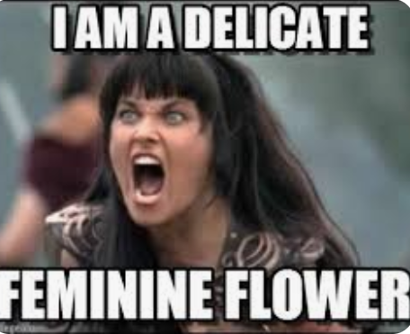

An interesting idea romance scams:
Altercasting: is a persuasion technique whereby the scammer projects a highly desirable identity onto their victim, who accepts the new identity. This helps to “prime” a victim’s behaviours.
For example: if Detective Huey uses his considerable powers of charm to convince me that I am a sweet, demure, fragile flower of femininity (bwahahahaha!!!), I might believe it and act accordingly.
BEFORE
AFTER

Slide 19
Dickinson Wang (2024) study of “altercasting”
They used data collected from a series of e-mail exchanges with 87 online romance fraudsters. To locate the fraudsters, we they used reports from stop-scammers.com.

Slide 20
The online romance fraudsters in their study attempted to persuade potential victims into neutralizing misgivings about sending money in the following inter-related ways:
neutralize victim misgivings by reframing the act of sending $$ as one that is necessary to address fraudsters’ needs (altercasting victims as ‘caring’, ‘supportive’)
recast the nature of their relationship from one that is potentially suspect to one that is romantic (victims altercast into the role of ‘romantic partner’)
Use language in their communications that could altercast victims into identities wherein sending money may be seen as less risky or as the morally correct thing to do.

Slide 21
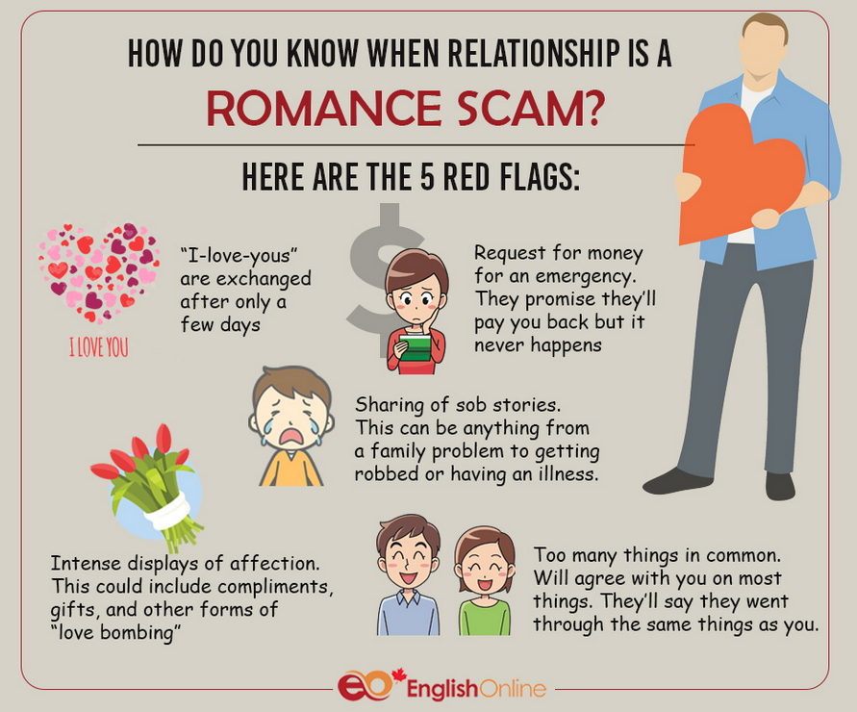

Slide 22

*all done!*

